Slide 1
COMP 3617 Final Project Parking Lot Manager
Alex Dai
April 7, 2016

Slide 2
Motivation
Users: Parking lot manager, Security staff, Customers
Provide real-time and full visibility of the facility
Reduce paperwork and persist data electronically

Slide 3
Technology Highlights
Zxing: 1D / 2D barcode image processing library
SQLite database
Most underground lots have weak network connectivity

Slide 4
Security and Authentication
Scan user badge to log in the app
By Device: Register IMEI in Database
By User: Admin or non-admin

Slide 5
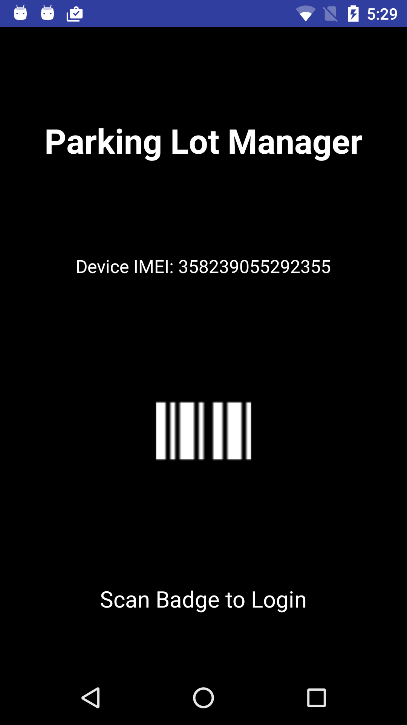
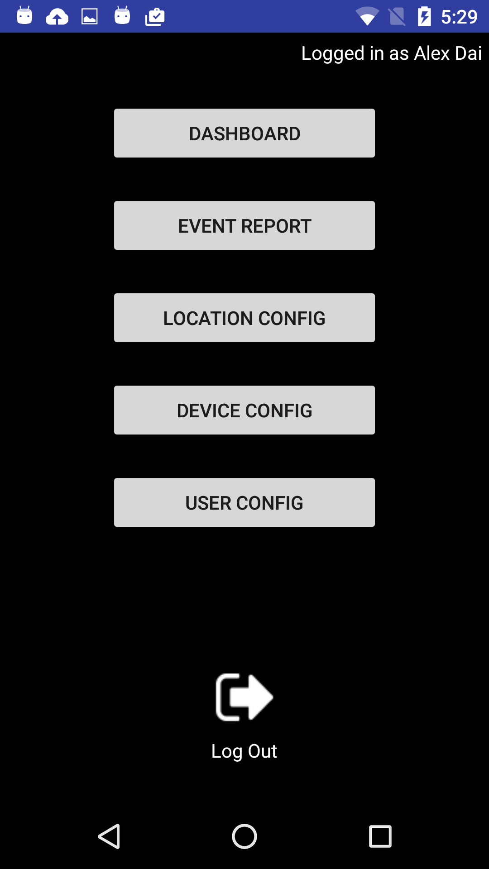

Slide 6
Components
Dashboard: Main operations
Event Report: Log event history
Location Config: Set up locations (Admin privilege)
Device Config: Register device (Admin privilege)
User Congfig: User permission (Admin privilege)

Slide 7
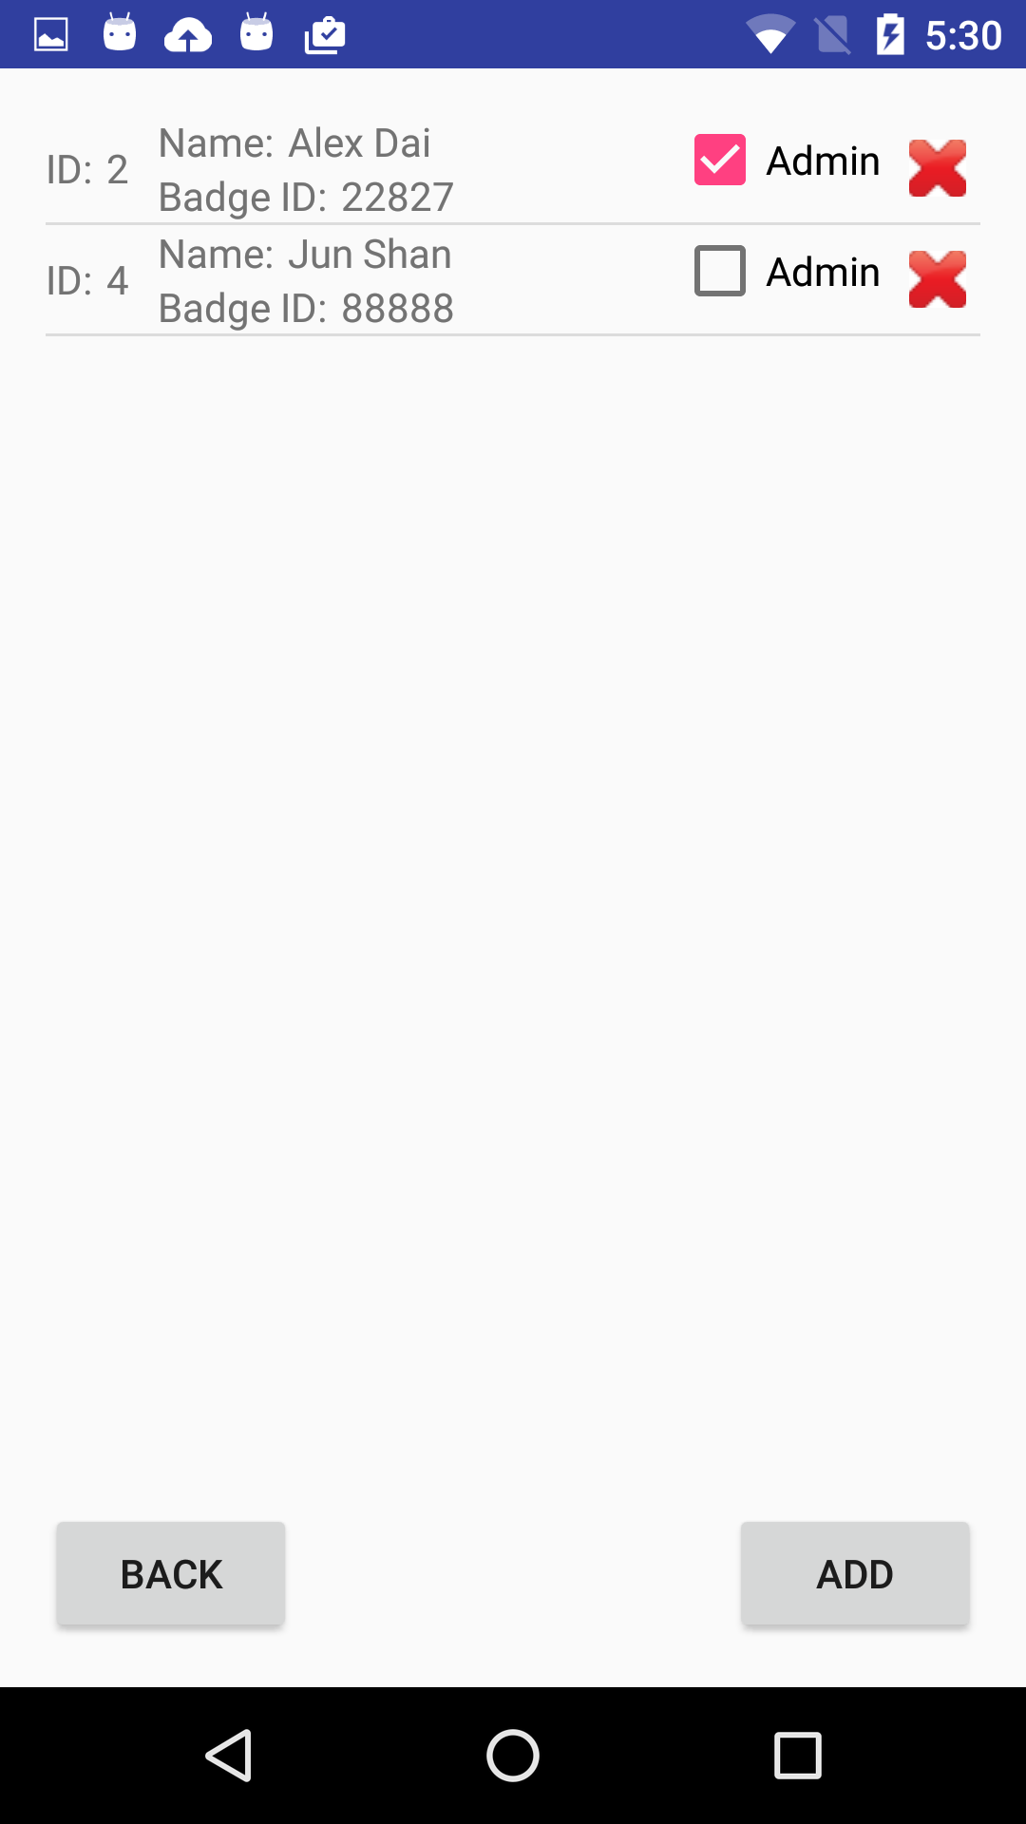

Slide 8
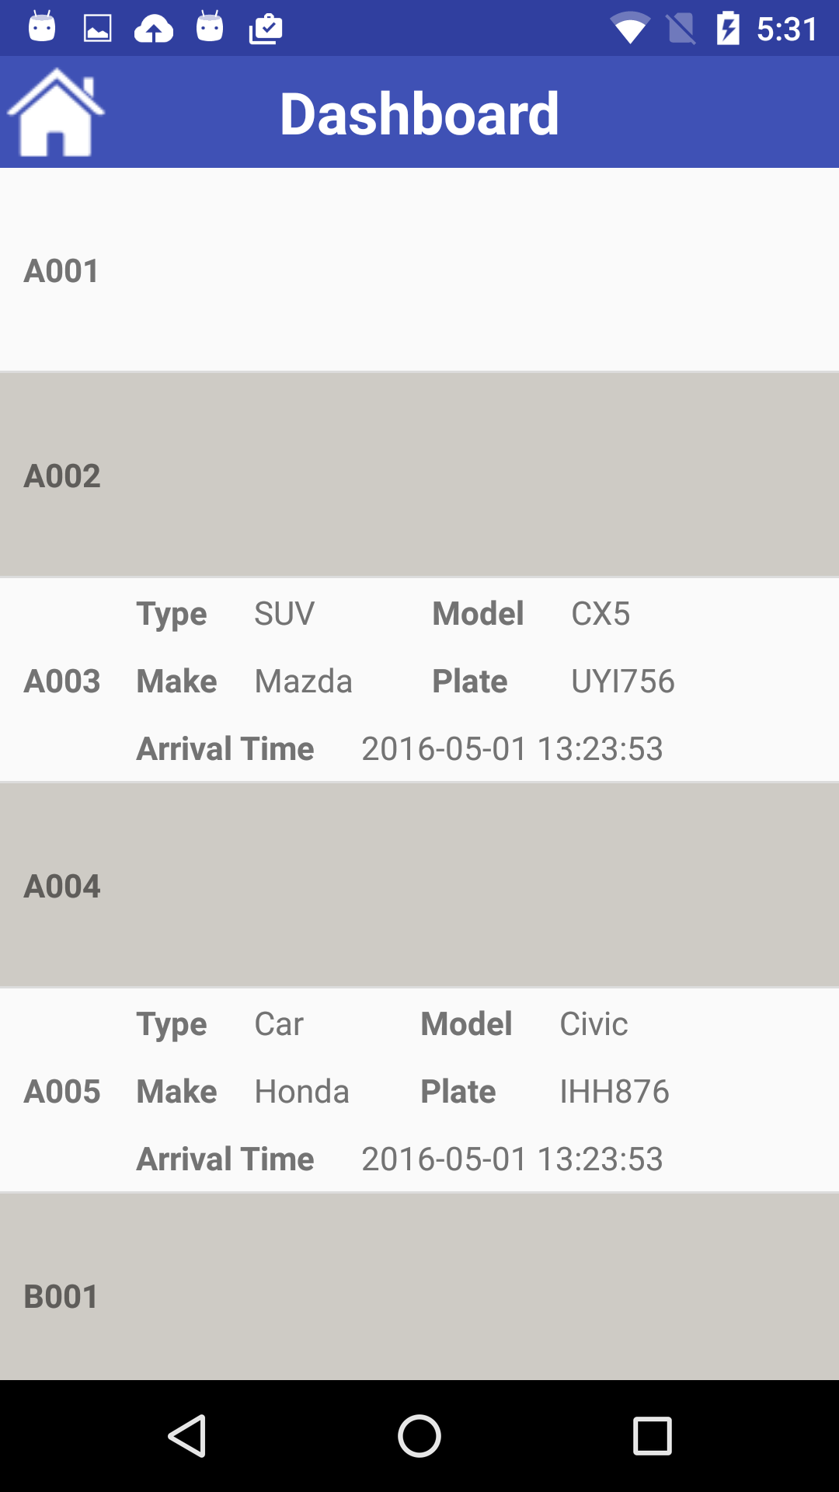
Dashboard
List of locations and vehicle details
Tap cell to enter detail view

Slide 9
Check In and Check Out
Assumption:
Single-capacity location
Reusable scannable tags
Check In: Enter vehicle details and scan tag
Check Out: Scan and return tag

Slide 10
Demo

Slide 11
Thank You!

